Slide 1
Hands on Activity
Volume
By Theresa Dabroski

Slide 2
Step 1
The measuring cup is a cylinder so the volume formula is:
V= πr²h, therefore we have to find the radius and height of the measuring cup.
The most accurate way to find the radius is to measure the circumference, plug that value into the circumference formula, solve for the diameter, then divide that in half to get the radius.
We just have to use the ruler to measure the height.
C = πd
8.5 = πd
3.0 ≈ d
1.5 ≈ r
The number of Starburst in the cup is 16.
Therefore, the ratio is:
V= πr²h
V = π(1.5)²(1.5)
V = π(3.375)
V ≈ 11.0 in³
r ≈ 1.5
h ≈ 1.5

Slide 3
Step 2
C = πd
9.5 = πd
3.0 ≈ d
r ≈ 1.5
h ≈ 4.0
V= πr²h
V = π(1.5)²(4.0)
V = π(9)
V ≈ 28.5 in³
Ratio:
=
X ≈ 41

Slide 4
Step 2 - % error
% error = x 100%
% error = x 100%
% error = 12.7 %

Slide 5
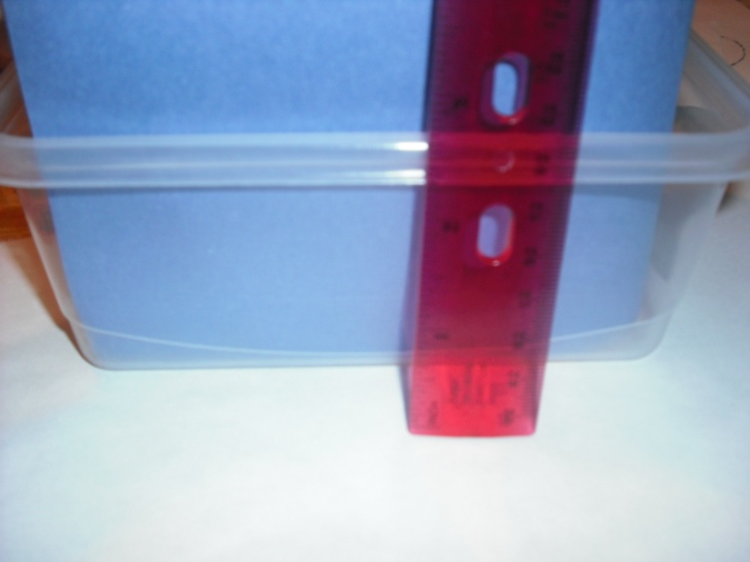
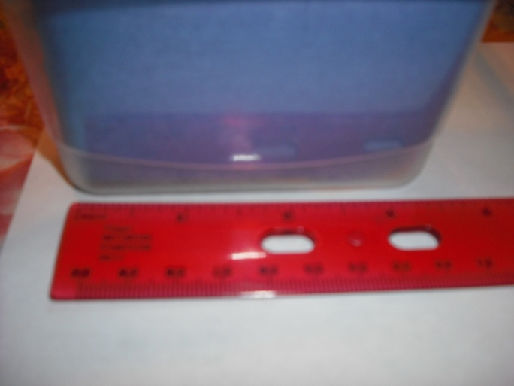
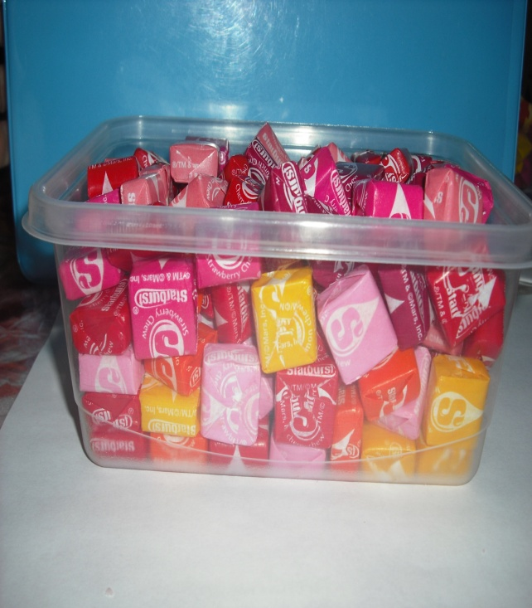
Step 3
V = lwh
V = (5.5)(3)(2.5)
V ≈ 41.0 in³
=
X ≈ 60 Starbursts
Ratio:

Slide 6
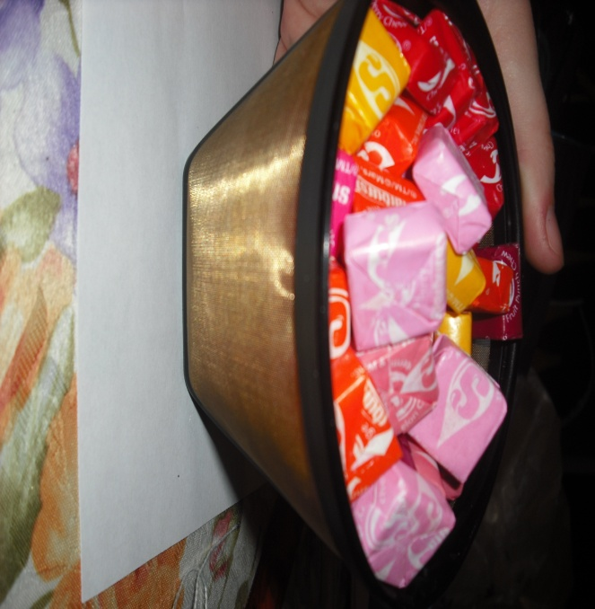
Step 4
V = π r² h
V= π (2.5)²(3.5)
V = π(21.875)
V ≈ 23.0 in³
^{Ratio:}
C = πd
14.5 = πd
5.0 ≈ d
r ≈ 2.5
h ≈ 3.5
=
X ≈ 33 Starbursts

Slide 7
Step 5
Object #4 is a bowl. Students will have to assume that the bowl is half of a sphere.
C = πd
20.5 = πd
6.5 ≈ d
r ≈ 3.5
Ratio:
V = π r³
V= π (3.5)³
V = π
V ≈ 90.0 in³
X ≈ 131 Starbursts
=

Slide 8
Other Questions
What do you think accounts for the percent of error?
Do you think the number of starbursts you calculated is accurate? Why or why not?
Why do you think that some objects with larger volumes contain less starburst than objects with smaller volumes?

